Slide 1
Object Oriented Programming using JAVA
Course Code | 22CS33 / 22IS33 | Course type | IPCC | Credits L-T-P | 3 - 0- 1
Hours/week: L-T-P | 3 - 0 - 2 |  |  | Total credits | 4
Total Contact Hours | L = 40Hrs; T = 0Hrs; P = 20Hrs Total = 60Hrs |  |  | CIE Marks | 100
Flipped Classes content | 10 Hours |  |  | SEE Marks | 100
Required Knowledge of: Procedure Oriented Programming Languages

Slide 2
Course Learning Objectives
1. | To understand the fundamentals of object-oriented programming and String class in Java.
2. | To demonstrate the object-oriented features such as encapsulation, inheritance and polymorphism to design and develop programs in Java.
3. | To understand exception handling mechanism supported in Java.
4. | To learn to use the data structures to organize data in the program using the collections framework in Java.
5. | To understand the concept of Packages, Interfaces and Lambda expressions in Java.

Slide 3
Course Outcome (COs) Learning Levels: Re - Remember; Un - Understand; Ap - Apply; An - Analysis; Ev - Evaluate; Cr - Create
At the end of the course, the student will be able to |  | Learning Level | PO(s) | PSO(s)
1. | Explain classes, objects, members of a class and relationships among them needed for a specific problem. | Un | 1,2,3,9,10,12 | 1,3
2. | Apply OOP principles (encapsulation, inheritance, polymorphism etc.) and proper program structure to write application programs. | Ap | 1,2,3,5,9,10,12 | 1,2,3
3. | Develop skills in writing programs using exception handling techniques. | Ap | 1,2,3,5,9,10,12 | 1,2,3
4. | Make use of the type hierarchy in the Collections Framework and Lambda expressions. | Ap | 1,3,9,10,12 | 1,3
5. | Experiment with the concept of packages and interfaces. | Ap | 1,3,9,10,12 | 1,3

Slide 4
Scheme of Continuous Internal Evaluation (CIE):
For integrated courses, a lab test also will be conducted at the end of the semester. The lab test COMPULSORY) will be part of the CIE. No SEE for Lab.
THEORY (60 marks) |  |  | LAB (40 marks) |  | Total
IA test 1 | IA test 2 | Assignment (OBA/Lab Project/ Industry assignment) | Conduction | Lab test
25 marks | 25 marks | 10 marks | 15 marks | 25 marks | 100 marks
IA Test: 1. No objective part in IA question paper 2. All questions descriptive
Conduct of Lab: 1. Conducting the experiment and journal: 5 marks 2. Calculations, results, graph, conclusion and Outcome: 5 marks 3. Viva voce: 5 marks
Lab test: (Batchwise with 15 students/batch) 1. Test will be conducted at the end of the semester 2. Timetable, Batch details and examiners will be declared by Exam section 3. Conducting the experiment and writing report: 5 marks 4. Calculations, results, graph and conclusion: 10 marks 5. Viva voce: 10 marks
Eligibility for SEE: 1. 40% and above (24 marks and above) in theory component 2. 40% and above (16 marks and above) in lab component 3. Lab test is COMPULSORY 4. Not eligible in any one of the two components will make the student Not Eligible for SEE

Slide 5
Scheme of Semester End Examination (SEE):
1. | It will be conducted for 100 marks of 3 hours duration
2. | Minimum marks required in SEE to pass: 40 out of 100
3. | Question paper contains two questions from each unit each carrying 20 marks. Students have to answer one full question from each unit.

Slide 6
Unit – I Contact Hours = 8 Hours
OOP Paradigm: The key attributes of object-oriented programming.
Java basics: The Java language, JDK, arrays, multidimensional arrays, alternative array declaration, assigning array references, using the length member, the for-each loop.
Introducing classes and objects: Class fundamentals, how objects are created, reference variables and assignment, String class

Slide 7
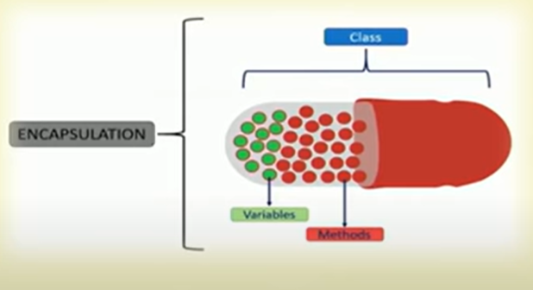
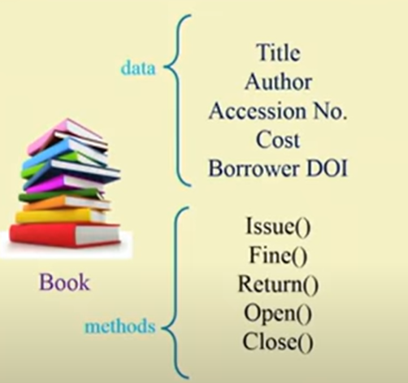
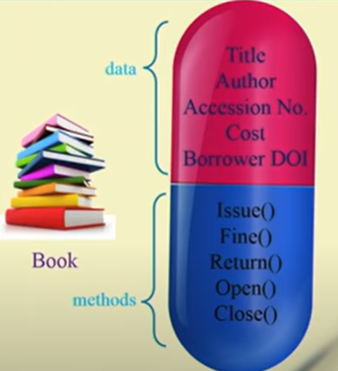
OOP Paradigm: The key attributes of object-oriented programming
Encapsulation: Encapsulation is a programming mechanism that binds together both code and data it manipulates. When code and data are linked together an object is created. The data is not accessible to outside world and only those methods which are wrapped in class can access it.
Data Hiding: Encapsulation allows you to hide the internal details of an object, exposing only the necessary interface to the outside world.
achieved through access modifiers (public, private, protected) in many object-oriented languages.
Information Hiding: It provides a mechanism to control the visibility of object internals, preventing unintended interference and ensuring data integrity.
The meaning of Encapsulation, is to make sure that "sensitive" data is hidden from users.
To achieve this, you must:
declare class variables/attributes as private
provide public get and set methods to access and update the value of a private variable
Example:

Slide 8
Data Hiding
class Circle {
private:
double radius;
public:
void setRadius(double r) {
if (r >= 0) {
radius = r;
}
}
double getRadius() const {
return radius;
}
};

Slide 9
Information Hiding
class Circle {
private:
double radius;
public:
void setRadius(double r) {
if (r >= 0) {
radius = r;
}
}
double getRadius() const {
return radius;
}
double getArea() const {
return 3.14159265359 * radius * radius;
}
};

Slide 10
Benefits of Encapsulation
Modularity: Encapsulation promotes modularity, allowing you to break down complex systems into smaller, more manageable components (objects).
Security : By restricting access to an object's data, you can control how data Security is modified and prevent unauthorized changes.
Ease of Maintenance: Changes to an object's internal implementation can be made without affecting other parts of the program that use the object's interface.

Slide 11
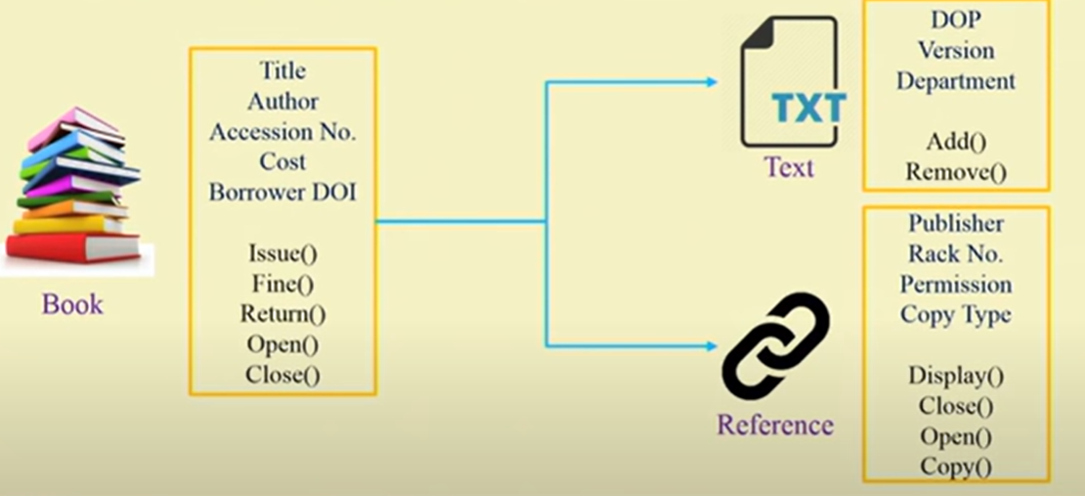
Inheritance : Inheritance is the process by which one object can acquire the properties of another object. In Java, it is possible to inherit attributes and methods from one class to another. We group the "inheritance concept" into two categories:
subclass (child) - the class that inherits from another class
superclass (parent) - the class being inherited from
To inherit a class ,use the extend keyword.

Slide 12
Polymorphism
Polymorphism: Polymorphism means "many forms", or one Interface multiple methods, and it occurs when we have many classes that are related to each other by inheritance. Inheritance lets us inherit attributes and methods from another class. Polymorphism uses those methods to perform different tasks. This allows us to perform a single action in different ways.
(One interface multiple methods)
Definition: Ability of different objects to respond to the same method or message in their own unique way.
Key Aspects:
Method Overriding: Polymorphism is often achieved through method overriding, where a subclass provides a specific implementation for a method defined in its superclass.
Interfaces: Interfaces and abstract classes provide a way to achieve polymorphism by defining a common set of methods that multiple classes can implement.

Slide 13
Benefits of Polymorphism
Code Reusability: Polymorphism promotes code reusability by allowing different classes to share a common interface. This reduces code duplication.
Flexibility: Polymorphism enables dynamic method invocation, allowing you to write code that can adapt to different object types at runtime.
Extensibility: It makes it easier to add new classes that conform to an existing interface, enhancing the extensibility of a system.

Slide 14
class A {
void display() {
System.out.println("Inside class A");
}
}
class B extends A {
@Override
void display() {
System.out.println("Inside class B");
}
}
public class PolymorphismExample {
public static void main(String[] args) {
A obj1 = new A();
A obj2 = new B();
obj1.display(); // Calls the display method of class A
obj2.display(); // Calls the overridden display method of class B
}
}

Slide 15
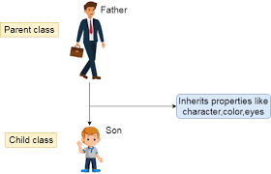
Inheritance
Definition: Inheritance is a mechanism in OOP that allows a new class (subclass or derived class) to inherit properties and behaviors from an existing class (superclass or base class).
The subclass can extend or override the inherited attributes and methods.

Slide 16
Key Aspects:
Superclass-Subclass Relationship: Inheritance establishes an "is-a" relationship between the derived class and the base class.
Code Reuse: Inheritance promotes code reuse by allowing a subclass to inherit the attributes and methods of a superclass, reducing redundancy.
Benefits of Inheritance:
Code Reusability: Inheritance allows you to build new classes based on existing ones, reducing the need to write similar code from scratch.
Hierarchy: It helps create class hierarchies that model real-world relationships, improving the organization of code.
Polymorphism: Inheritance is closely related to polymorphism, enabling the use of common interfaces and dynamic method dispatch.

Slide 17
Inheritance(Sample)
class Employee{
float salary=40000;
}
class Programmer extends Employee{
int bonus=10000;
public static void main(String args[]){
Programmer p=new Programmer();
System.out.println("Programmer salary is:"+p.salary);
System.out.println("Bonus of Programmer is:"+p.bonus);
}
}

Slide 18
Java basics: The Java language
The Java was chosen for two primary reasons:
1st it is one of the worlds most widely used computer language.
2nd its features are designed and implemented in such a way that makes it easy to demonstrate the foundations of programming.
The Origin of Java
Java’s Contribution to the Internet
Java Applets
Security
Portability
Java’s Solution :The Bytecode
The Evolution of Java.

Slide 19
The Origin of Java
Year | Development
1991 | Java was conceived by James Gosling & others @ Sun Microsystems in 1991 . It was initially called “oak’’ by James Gosling. ’’. Oak was renamed “Java”. Gosling and others began to work on portable ,cross-platform language that could run on variety of CPU’s under different platform. The WWW (World Wide Web) appeared on internet due to which Java programs were portable.
1993 | Web applets(tiny programs) using the new language that could run on all the types of computer connected to Internet.
1994 | The team developed a Web browser called “Hot Java” to locate & run applet program on Internet.
1995 | Oak was renamed “Java Java is an island of Indonesia where first coffee was produced.
1996 | JDK(Java Development Kit) 1.0 released in January 23,1996.

Slide 20
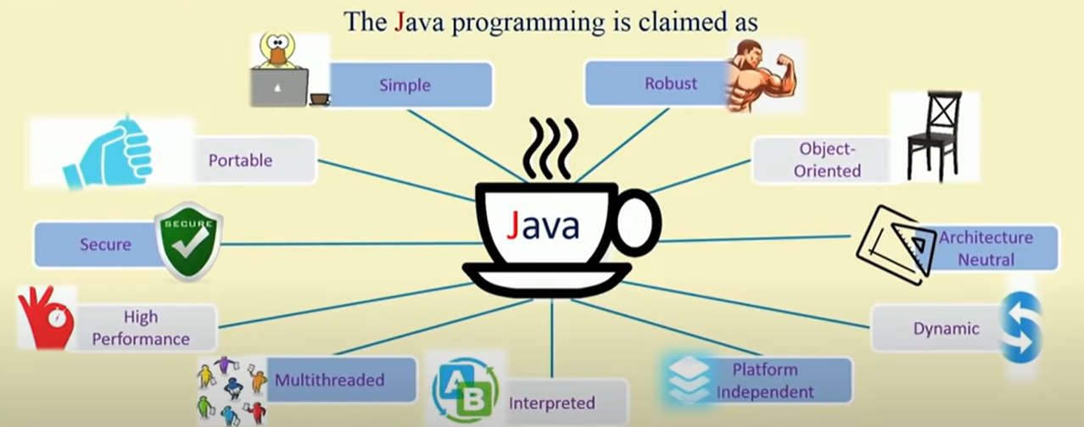

Slide 21
Java’s Contribution to the Internet: Java innovated a new type of networked program called applet, but it had issues with the Internet I,e. Portability and security.
Java Applets: Applet is a special type of a program that is embedded in the webpage to generate a dynamic content .It runs inside the browser and works at client side.
Drawbacks :Applets presented a serious challenges interms of Security and Portability.
Security : Every time when you download the “normal program ‘’ it may contain virus like Torjan Horse or some harmful code which may cause damage to the system.
Java achieved this protection by confining an applet to the Java execution environment and not allowing it to access to other parts of the computer.
Portability: Portability is a major aspect of the Internet because many different types of computer and operating system are connected to it. When ever a program is downloaded it must be able to run on that system. Therefore some means of generating portable executable code was needed. Same mechanism that ensures security also helps create portability.

Slide 22
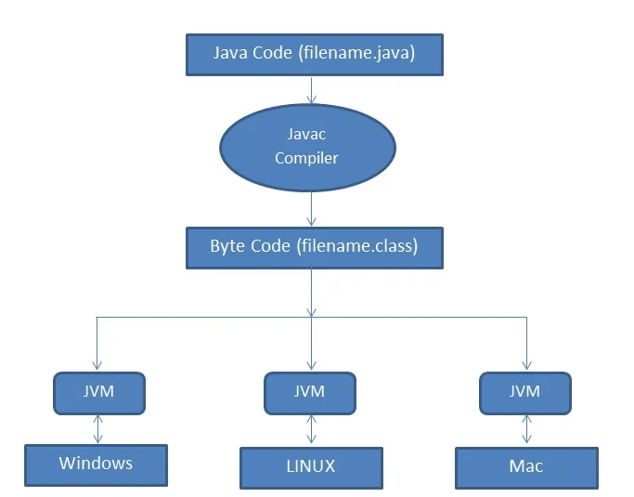
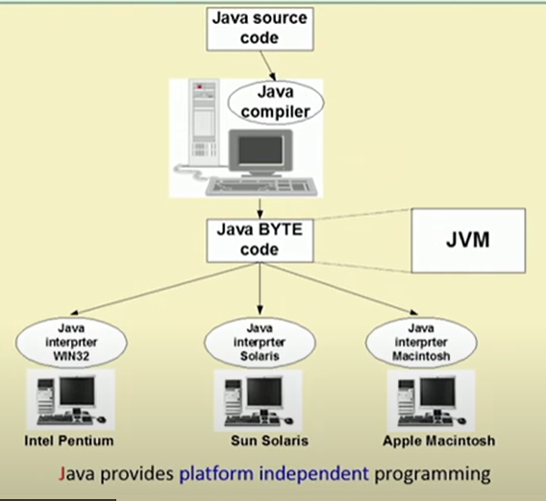
Java’s Solution :The Bytecode
As soon as a Java program is compiled bytecode is generated.
Bytecodes are non-runnable codes that rely on the availability of an interpreter, this is where JVM comes into play.
Byte code is a machine-level language code that runs on the JVM.
Bytecode adds portability to Java which resonates with the saying, “write once, read anywhere”.
JVM, loads, verifies and executes Java bytecode. It is known as the interpreter or the core of Java programming language because it executes Java programming.

Slide 23
The Evolution of Java: Java is a programming language that was first released in 1995 by
Sun Microsystems (now owned by Oracle).
Since its initial release, Java has undergone several updates and changes, with the most recent version being Java 15, which was released in September 2020.
Some of the major updates and changes to Java over the years include:
Java 1.1 (1997): Introduced the event-delegation model for event handling, inner classes, and JavaBeans.
Java 2 (1998): Included the introduction of the Java Standard Edition (J2SE) and the Java Enterprise Edition (J2EE).
Java 5 (2004): Introduced generics, annotations, and the for-each loop.
Java 7 (2011): Introduced the try-with-resources statement and the diamond operator for generic types.
Java 8 (2014): Included the introduction of lambda expressions and functional interfaces, as well as the Streams API.
Java 9 (2017): Included the introduction of the Java Platform Module System (JPMS), as well as improvements to the Java shell (JShell) and the HTTP client.
Java 10 (2018): Introduced local-variable type inference and additional improvements to the JPMS.
Java 11 (2018): Java 11 was the first Long-term support release with a new release cycle, where Oracle releases a new version every six months, and supports each release for three years. This release introduced the removal of the JavaEE and CORBA modules, and the introduction of the HTTP client.
Java 12 (2019), Java 13 (2019), Java 14 (2020) and Java 15 (2020) : These releases have introduced new features and improvements such as new switch expressions, text blocks, and pattern matching for instanceof.

Slide 24
JDK: The Java Development Kit.
The JDK (Java Development Kit) is a software development kit that develops applications in Java
The JDK provides two primary programs.
First is javac which is a Java compiler which is used to compile java programs, it takes .java file as input and produces bytecode.
Following is the syntax of this command .It converts your source code into bytecode.
javac sample.java
Second The java command is used to execute the bytecode of java. It takes byte code as input and runs it and produces the output. Following is the syntax of this command.
java sample

Slide 25
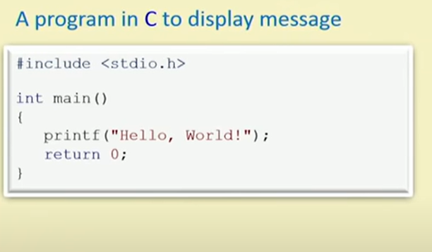
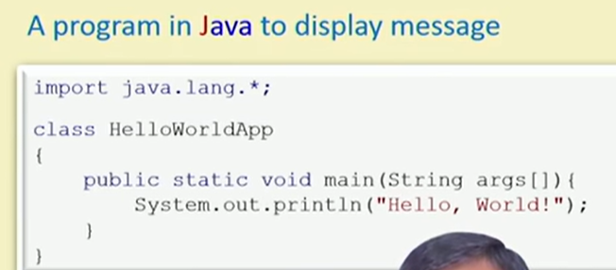
A First Example

Slide 26
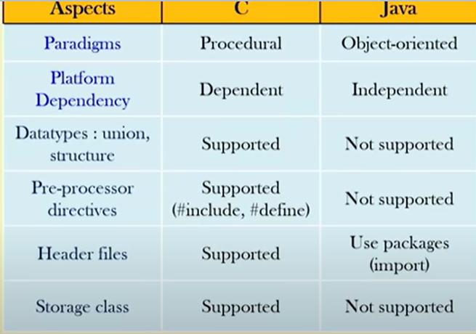
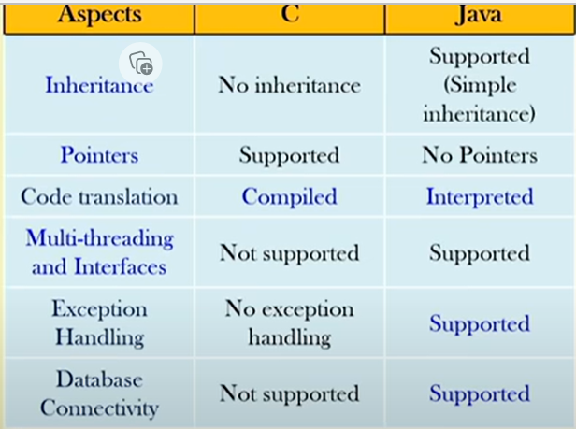

Slide 27
A First Example:
Every application begins with a class name and that class name must match the file name.
Let us first create a Java file as Example.java that prints "Hello, World!" to the console:
public class Example {
public static void main(String[] args) {
System.out.println("Hello, World!");
}
}
Every line of the code must be included inside the class.
The class begins with opening { and closing }braces. The elements between the two braces are members of class.
public static void main(String[] args) {
The line starts with the public keyword which indicates access modifier.
static: the keyword static allows main() to be executed independently of any object..
void: This is a return type. The main method doesn't return any value, so it is declared with void.
main: This is the name of the method. The main method is the entry point of the Java program. It's the method that gets executed when you run the program.

Slide 28
If class is private ,which prevents the members from being used by code defined outside of its class.
Main method has one parameter i.e String[] args, which declares the parameter named args. This is an array of objects of type String. i.e args receives any command line arguments present when the program is executed.
{: This symbol is an opening curly brace, marking the beginning of the main method block. All the code related to the main method is enclosed within these curly braces.
System.out.println("Hello, World!");
The line outputs the string “Hello , World!” followed by new line on the screen.
System – is a predefined class that provides access to the system
out– is an output stream that is connected to the console.
println—displays the string.
}: This closing curly brace marks the end of the main method block.
}: This closing curly brace marks the end of the Example class block.

Slide 29
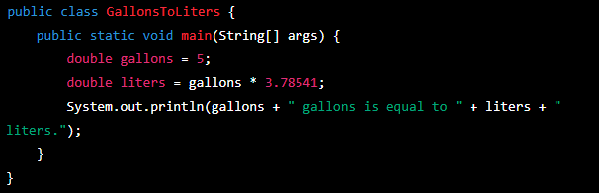
Converting Gallons to Liters
Explanation:The program begins by declaring a variable gallons and assigning a value of 5 to it .
The program then performs the conversion by multiplying the number of gallons by the conversion factor (3.78541) and storing the result in the variable liters..
Finally, the program prints the result of the conversion to the console using the System.out.println method .

Slide 30
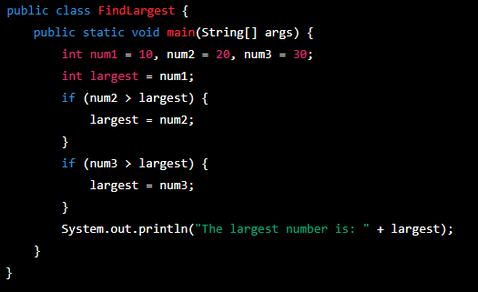
WAP in Java to find the largest of 3 numbers
.
The program begins by declaring three variables num1, num2, num3 and assigning values 10, 20, 30 to them respectively.
The program then declares a variable largest and assigns the value of num1 to it.
The program then uses an if-else statement to check if num2 is greater than largest. If it is, then the value of num2 is assigned to largest
The program then uses another if-else statement to check if num3 is greater than largest. If it is, then the value of num3 is assigned to largest.
Finally, the program prints the largest number using the System.out.println method.
When you run this program, it will display the largest number among num1, num2 and num3 which are assigned in the program.

Slide 31
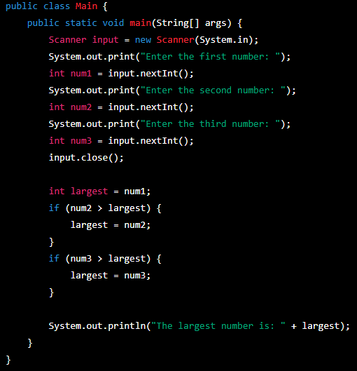
Find the largest of 3 numbers using scanner class
In this program, we are using a scanner object to take input from the user for three numbers. Then using if-else statement to find the largest of three numbers and print the largest number.

Slide 32
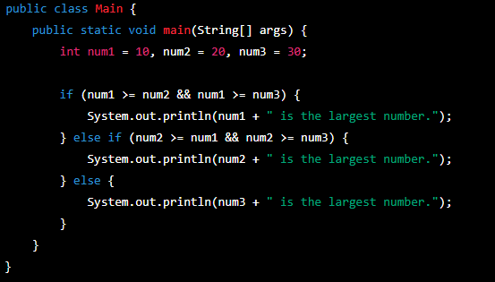

Slide 33
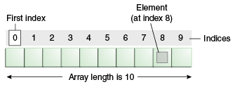
Arrays
In Java, an array is an object which is a collection of elements of the same data type. The elements of an array are stored in contiguous memory locations, and each element can be accessed by its index.
Array in Java is index-based, the first element of the array is stored at the 0th index, 2nd element is stored on 1st index and so on. We can store only a fixed set of elements in a Java array.
Like C/C++, we can also create single-dimensional or multidimensional arrays in Java.

Slide 34
Advantages
Code Optimization: It makes the code optimized, we can retrieve or sort the data efficiently.
Random access: We can get any data located at an index position.
Disadvantages
Size Limit: We can store only the fixed size of elements in the array. It doesn't grow its size at runtime. To solve this problem, a collection framework is used in Java which grows automatically.

Slide 35
One Dimensional Array
Syntax to Declare an Array in Java
datatype arrayName[] = new datatype[size];
dataType[] arr; (or)
dataType []arr; (or)
dataType arr[];
datatype: is the type of the elements that we want to enter in the array, like int, float, double, etc.
arrayName: is an identifier.
new: is a keyword that creates an instance in the memory.
size: is the length of the array.
// Declaring an array example
int[] myArray;

Slide 36
Instantiation of an Array in Java
arrayRefVar=new datatype[size];
// Initializing an array
myArray = new int[5];

Slide 37
public class Main{
public static void main(String[] args) {
int myarray[]; //Declaring an array
myarray= new int[5]; //Initializing an array//
//Assign values to the array
myarray[0]=1;
myarray[1]=2;
myarray[2]=3;
//Accessing elements of an array
for(int i=0;i<3;i++) System.out.println(myarray[i]);
}
}

Slide 38
Example of Java Array
/Java Program to illustrate how to declare, instantiate, initialize
//and traverse the Java array.
class Main{
public static void main(String args[]){
int a[]=new int[5];//declaration and instantiation
a[0]=10;//initialization
a[1]=20;
a[2]=70;
a[3]=40;
a[4]=50;
//traversing array
for(int i=0;i<a.length;i++) //length is the property of array
System.out.println(a[i]);
}
}

Slide 39
//Let's create a program that takes a single-dimensional array as input
import java.util.Scanner;
public class scanne1 {
public static void main(String[] args) {
int n;
Scanner sc= new Scanner(System.in);
System.out.println("Enter how many elements you want to store");
n=sc.nextInt(); //The nextInt() method scans the next token of the input data as an “int”.
int[] array =new int[10];
System.out.println("Enter the elements of array");
for(int i=0;i<n;i++){
array[i]= sc.nextInt();
}
System.out.println("Array elements are");
for(int i=0;i<n;i++)
{
System.out.println(array[i]);
}
}
}

Slide 40
import java.util.Scanner;
public class Main {
public static void main(String[] args) {
int n;
Scanner sc= new Scanner(System.in);
System.out.println("Enter how many elements you want to store");
n=sc.nextInt(); //The nextInt() method scans the next token of the input data as an “int”.
int[] array =new int[10];
System.out.println("Enter the elements of array");
for(int i=0;i<n;i++){
array[i]= sc.nextInt();
}
System.out.println("Array elements are");
for(int i=0;i<n;i++)
{
System.out.println(array[i]);
}
}
}

Slide 41
Find the minimum and maximum value in an array
import java.util.Scanner;
public class MinMax {
public static void main (String[] args) {
int[] nums=new int[10];
int min , max , n;
Scanner sc = new Scanner(System.in);
System.out.println("Enter the number of elements you want to store: ");
n= sc.nextInt();
System.out.println("Enter the elements of the array: ");
for(int i=0;i<n ; i++)
nums[i]=sc.nextInt();
System.out.println("Array elements are: ");
for(int i=0 ; i<n ; i++) {
System.out.println(nums[i]); }
min=max=nums[0];
for (int i=1;i<n;i++) {
if(nums[i]<min)
min=nums[i];
if(nums[i]>max)
max=nums[i]; }
System.out.println("Min And Max=" + min + " " + max); } }

Slide 42
import java.util.Scanner;
public class Main {
public static void main (String[] args) {
int[] nums=new int[10];
int min , max , n;
Scanner sc = new Scanner(System.in);
System.out.println("Enter the number of elements you want to store: ");
n= sc.nextInt();
System.out.println("Enter the elements of the array: ");
for(int i=0;i<n ; i++)
nums[i]=sc.nextInt();
System.out.println("Array elements are: ");
for(int i=0 ; i<n ; i++) {
System.out.println(nums[i]); }
min=max=nums[0];
for (int i=1;i<n;i++) {
if(nums[i]<min)
min=nums[i];
if(nums[i]>max)
max=nums[i]; }
System.out.println("Min value from array is =" + min + " and Max value from array is =" + max);
} }

Slide 43
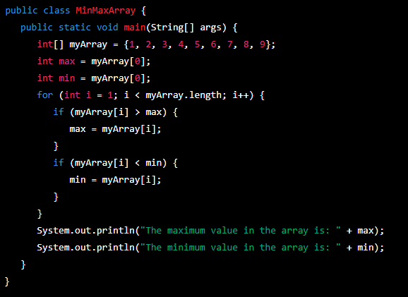
Find minimum and maximum to from array without using scanner function.

Slide 44
Array boundaries are strictly enforced in Java.
It is run time error to over run or under run an array.
For example demonstration of ARRAY OVERRUN
class ArrayErr{
public static void main(String[] args) {
int[] sample =new int[10];
int i;
// generate an array over run
for(i=0;i<100;i++)
sample[i]= i;
}
}
As soon as i reaches 10, an ArrayIndexOutOfBoundsException is generated and the program is terminated.

Slide 45
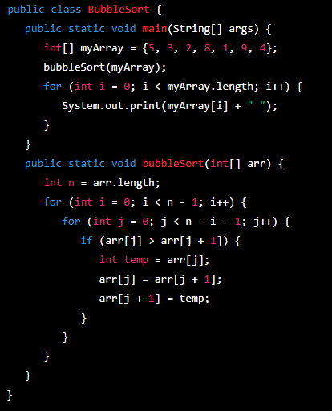
Sorting an Array using Bubble sort.

Slide 46
public static void bubbleSort(int[] arr) {
int n = arr.length;
boolean flag;
for (int i = 0; i < n - 1; i++) {
flag = false;
for (int j = 0; j < n - i - 1; j++) {
if (arr[j] > arr[j + 1]) {
// Swap arr[j] and arr[j+1]
int temp = arr[j];
arr[j] = arr[j + 1];
arr[j + 1] = temp;
flag = true;
}
}
// If no two elements were swapped in inner loop, the array is already sorted
if (!flag) {
break;
}
}
}
public class Main {
public static void main(String[] args) {
int[] arr = {12,02,53,74,15};
System.out.println("Original Array:");
printArray(arr);
bubbleSort(arr);
System.out.println("Sorted Array:");
printArray(arr);
}

Slide 47
public static void printArray(int[] arr) {
for (int value : arr) {
System.out.print(value + " ");
}
System.out.println();
}
}

Slide 48
class Main {
public static void main(String[] args) {
int[] myArray = {1, 2, 3, 4, 5, 6, 7, 8, 9};
int keyelem = 2;
int result = binarySearch(myArray, keyelem);
if (result == -1) {
System.out.println("Element not found");
} else {
System.out.println("Element found at index: " + result);
}
}

Slide 49
public static int binarySearch(int[] arr, int target) {
int left = 0;
int right = arr.length - 1;
while (left <= right) {
int mid = left + (right - left) / 2;
if (arr[mid] == target) {
return mid;
}
if (arr[mid] < target) {
left = mid + 1;
} else {
right = mid - 1;
}
}
return -1;
}
}

Slide 50
Multidimensional Array
In Java, a multidimensional array is an array of arrays. It can be used to represent a table with rows and columns, or a matrix, or a grid.
Example of how to declare and initialize a two-dimensional array in Java
int[][] myArray = new int[3][3];
This creates a 2-dimensional array with 3 rows and 3 columns. Each element of the array is initialized with the default value for the int data type, which is 0.
Syntax to Declare and Initialize a two-dimensional array :
int[][] myArray = {{1, 2, 3}, {4, 5, 6}, {7, 8, 9}};
In this example, the array named "myArray" is being declared as a 2-dimensional array of integers, and it is being initialized with the values 1, 2, 3, 4, 5, 6, 7, 8, 9.

Slide 51
Assigning array references
In Java, arrays are objects that store multiple values of the same data type. You can create an array by specifying the type of data it will hold, followed by square brackets and the name of the array. For example, to create an array of integers called "numbers", you would use the following syntax:
int[] numbers;
You can also initialize an array when you create it by specifying its size and the values it will hold. For example:
int[] numbers = {1, 2, 3, 4, 5};
Once you have an array, you can access its elements by using the array name followed by the index of the element in square brackets. For example:
System.out.println(numbers[0]); // prints 1

Slide 52
You can also assign new values to specific elements of an array using the same syntax:
numbers[0] = 10;
You can also create a reference to an array using the same syntax.
int[] numbers = {1, 2, 3, 4, 5};
int[] copy = numbers;
.

Slide 53
Using the length member
length is an instance variable that contains the size of array.
Example:
int[ ] a={10,20,30,40,50};
int len = a.length //get the size of array.
system.out.println(len); //outputs 5

Slide 54
for-each loop
In Java, the for loop and the for-each loop (also known as the enhanced for loop) are both used to iterate over the elements of an array or any other iterable object.
The syntax for a for each loop (also known as a "for each" loop) is as follows:
‘type’ is the data type of the items in the collection.
‘variable’ is the variable that will be assigned the value of each item in the collection, one at a time.
‘collection ‘ is the collection of items over which the loop will iterate. This could be an array, a list, a set, or any other type of collection.
for (type variable : collection) {
// code to be executed
}

Slide 55
For example, the following for each loop iterates over an array of integers and prints each value:
int[ ] numbers = {1, 2, 3, 4, 5};
for (int num : numbers) {
System.out.println(num); }
//The output would be
1
2
3
4
5
It's important to note that the for-each loop is used for only iterating over elements of an array or collections, it can't be used to iterate over the range of integers or anything like that.

Slide 56
Q. Write a program to add sum of array using for-each loop.
public class ForEach {
public static void main(String[] args) {
int [] nums={1,2,3,4,5,6,7,8,9,10};
int sum=0;
//use for each loop to display and sum the value.
for(int x:nums){
System.out.println(x);
sum=sum+x;
}
System.out.println("Summation =" +sum);
}
}

Slide 57
Write a Java program display a pattern as shown below using a looping structure.
1
22
333
4444
55555

Slide 58
public class Main {
public static void main(String[] args) {
int rows = 5; // Number of rows in the pattern
for (int i = 1; i <= rows; i++) {
for (int j = 1; j <= i; j++) {
System.out.print(i);
}
System.out.println();
}
}
}

Slide 59
Define the process of building and running Java program. And write a Java program to accept a number and check whether it is prime or not.

Slide 60
import java.util.Scanner;
public class PrimeChecker {
public static void main(String[] args) {
Scanner scanner = new Scanner(System.in);
System.out.print("Enter a number: ");
int number = scanner.nextInt();
if (isPrime(number)) {
System.out.println(number + " is a prime number.");
} else {
System.out.println(number + " is not a prime number.");
}
}
public static boolean isPrime(int number) {
if (number <= 1) {
return false;
}
for (int i = 2; i <= Math.sqrt(number); i++) {
if (number % i == 0) {
return false;
}
}
return true;
}
}

Slide 61
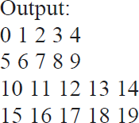
Write a Java program display a pattern as shown below using a looping structure

Slide 62
class Main {
public static void main(String args[]) {
int twoD[][]= new int[4][5];
int i, j, k = 0;
for(i=0; i<4; i++)
for(j=0; j<5; j++) {
twoD[i][j] = k; k++;
}
for(i=0; i<4; i++) {
for(j=0; j<5; j++)
System.out.print(twoD[i][j] + " ");
System.out.println();
}
}
}

Slide 63
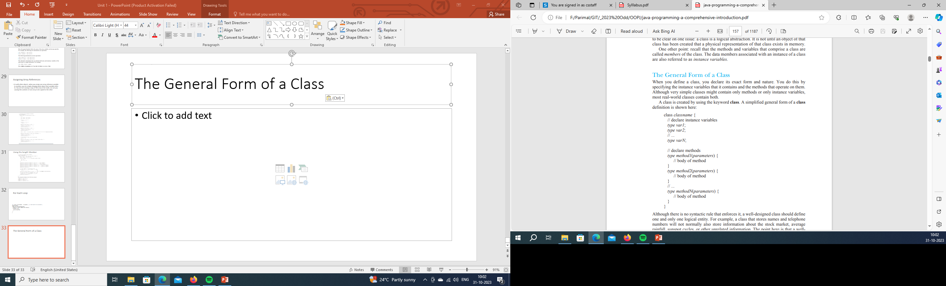
Introducing classes and objects: The General Form of a Class
Notes:
access modifier: Specifies the accessibility of the class, such as public, private, or protected. If no access modifier is specified, the class is given default access (accessible within the same package).
class: The keyword used to declare a class in Java.
ClassName: The name of the class, which should begin with a capital letter and follow camel case naming conventions.
{ }: The curly braces that enclose the class body, where fields and methods are defined.

Slide 64
class Vehicle{
int passengers;
int fulecap;
int mpg;
}
class SimpleIntrest{
double p,t,r;
double calcSI() {
return (p*t*r)/100;
}
}

Slide 65
How objects are created
In Java, objects are created using the new keyword, followed by the constructor of the class.
The general syntax for creating an object is as follows:
ClassName objectName = new ClassName(parameters);
‘className’ is the name of the class.
‘objectName’ is the name of the object (variable) that refers to the created object.
‘new ClassName(parameters)’ is a call to the constructor of the class, passing in any necessary parameters.
Notes:
className is the name of the class.
objectName is the name of the object (variable) that refers to the created object.
new ClassName(parameters) is a call to the constructor of the class, passing in any necessary parameters.
For example, using the Student class that I provided in the previous response, we can create an object of the class as follows:
Once an object is created, we can call its methods or access its fields using the dot (.) operator. For example,

Slide 66
For example, using the Student class , we can create an object of the class as follows:
Student student1 = new Student("John",20,"Computer Science");
Accessing class members
Once an object is created, we can call its methods or access its fields using the dot (.) operator.
The general form of the dot operator is
Object.member
For example,
System.out.println(student1.getName());

Slide 67
/*program that uses the vehicle class*/
class Vehicle{
int passengers;
int fulecap;
int mpg;
}
Class VehicleDemo{
public static void main(String[] args){
Vehicle minivan= new Vehicle();
int range;
minivan.passangers=7;
minivan.fulecap=16;
minivan.mpg=21;
//compute the range assuming full tank of gas
range= minivan.fulecap*minivan.mpg;
System.out.println(“Minivan can carry”+minivan.passangers+ ”with a range of “+range);

Slide 68
class Calculator {
int x,y;
int Sum() {
return x+y;
}
}
public class Main{
public static void main(String[] args) { Calculator calc = new Calculator(); calc.x = 10;
calc.y =20;
System.out.println("Sum is:"+calc.Sum());
}
}

Slide 69
import java.util.Scanner;
class SI{
double p,t,r;
double calcSI(){
return (p*t*r)/100;
}
}
public class Main{
public static void main(String[] args){
double pi,ti,re, interest;
Scanner sc = new Scanner(System.in);
pi = sc.nextDouble();
ti = sc.nextDouble();
re = sc.nextDouble();
SI s = new SI();
s.p = pi;
s.t= ti;
s.r = re;
interest = s.calcSI(); System.out.println("Interest is:"+interest); }
}

Slide 70
import java.util.Scanner;
class SI{
double calcSI(int p,int t , int r){
return (p*t*r)/100;
}
}
public class Main{
public static void main(String[] args){
double pi,ti,re, interest;
SI s = new SI();
interest = s.calcSI(100,10,5); System.out.println("Interest is:"+interest); }
}

Slide 71
Methods
Methods are the subroutines that manipulates the data defined by the class and in many cases control access to that data.
main() is reserved for the method that begins execution of the program.
The general form is as shown here:
return-type name(parameter list)
{
//body of method
}

Slide 72
Reference variables and assignment
When one primitive-type is assigned to another, i.e., the statements int x=y means that
x receives a copy of the value contained in y.
Hence, after the assignment, both x and y will contain their own, independent copies of the value. Changing one does not affect the other.
But, when one object variable is assigned to another, the situation is bit different because you are assigning references.
This means that you are changing the object that the reference variable refers to, not making a copy of that object
For example,
Box b1=new Box();
Box b2=b1;
In this case b1and b2 will both refer to the same object. Therefore, object can be changed through b1 or b2.
b1.width = 12;
System.out.println(b1.width);
System.out.println(b2.width);
After executing both of these println() statements, we get the same value for both the statements as 12.

Slide 73
STRINGS
In Java, a string is defined as an object
Constructing Strings: by using new keyword and calling a string constructor
For example:
String str1 = "Hello World"; //Using String literal
String str2 = new String("Hello World"); //Using new operator
char[] charArray = {'H', 'e', 'l', 'l', 'o', ' ', 'W', 'o', 'r', 'l', 'd'};
String str3 = new String(charArray);

Slide 74
Example:
class Main {
public static void main(String args[]) {
String str1 = new String("hello");
String str2 = new String(str1);
String str3 = "Well come to Java";
System.out.println(str1);
System.out.println( str2+"\n"+ str3);
}
}

Slide 75
Once a String object is created, you can perform various operations on it such as:
Concatenation using the "+" operator or the concat() method
Comparison using the equals() method or the "==" operator
Finding the length of a string using the length() method
Extracting a substring using the substring() method
Replacing part of a string using the replace() method
Converting to lowercase or uppercase using the toLowerCase() or toUpperCase() method
etc.

Slide 76
Few examples are:
String str1 = "Hello";
String str2 = "World";
String str3 = str1 + " " + str2; // "Hello World"
System.out.println(str1.length()); // 5
System.out.println(str3.substring(0, 5)); // "Hello"
System.out.println(str3.toUpperCase()); // "HELLO WORLD"

Slide 78
Consider the below example
String str1 = “Java”; String str2 = “JAVA”; String str3 =JavaJava;
boolean equals(str)
str1.equals(str2) returns false, as invoking string str1 does not have same character sequence as str2.
int length( )
str1.length( ) returns 4
char charAt(index)
str1.charAt(2) returns character “v” as index starts from 0
int compareTo(str)
str1. compareTo(str2) returns 32, as ASCII value of “a” is 32 times greater than “A”
int indexOf(str)
str3.indexOf(“Java”) returns 0, as it returns the index of the first match
int lastIndexOf(str)
str3.lastIndexOf(“Java”) returns 4, as it returns the index of the last match

Slide 79
Program on String Operations
public class StrOps {
public static void main(String[] args) {
String str1="when it comes to web programming ,java is 1";
String str2 =new String(str1);
String str3="Java strings are powerfull";
int result,idx;
char ch;
System.out.println("length of str1 " + str1.length());
//display str1 , one character at a time
for(int i=0;i<str1.length();i++)
System.out.print(str1.charAt(i));
System.out.println();
if(str1.equals(str2))
System.out.println("str1 equals str2");
else
System.out.println("str1 does not equals str2");
if(str1.equals(str3))
System.out.println("string1 equals string3");
else
System.out.println("string1 does not equals string3");
result=str1.compareTo(str3);
if(result== 0)
System.out.println("string1 and 3 are equal");
else if(result<0)
System.out.println("string1 is less than string3");
else
System.out.println("string1 is greater than string3");
//assign a new string to str2
str2="One Two Three One";
idx=str2.indexOf("one");
System.out.println("Index of first occurance of One:" +idx);
idx=str2.lastIndexOf("one");
System.out.println("Index of first occurance of One:" +idx);
}
}

Slide 80
Output:
Length of str1: 45
when it comes to web programming ,java is 1
str1 equals str2
string1 does not equals string3
string1 is greater than string3
Index of first occurance of One: 0
Index of first occurance of One: 14

Slide 81
Arrays Of Strings
Like any other data type strings can be assembled into arrays. For example:
public class StringArrays {
public static void main(String[] args) {
String[] strs={"This" , "is" , "a" , "test."};
System.out.println("Original array");
for (String s:strs)
System.out.print(s + " ");
System.out.println("\n");
//change a string in the array
strs[1]="was";
strs[3]="test,too !";
System.out.println("Modified array:");
for (String s:strs)
System.out.print(s + " "); } }
OutPut:
Original array
This is a test.
Modified array:
This was a test,too !

Slide 82
Strings are Immutable
Java, strings are immutable, meaning their value cannot be changed once they are created.
Therefore, all the methods that are defined above don’t alter the original String object
This means that any operations that appear to change the value of a string, such as concatenation or replacement, will actually create a new string object with the modified value.

Slide 83
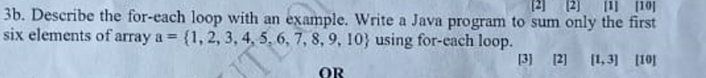
Previous Year Questions
Explain the following terms with respect to string in JAVA.
charAt()
indexOf()
compareTo()
toCharArray()
toLowerCase()
Notes:
Previous Year Questions

Slide 84
public class SumFirstSixElements {
public static void main(String[] args) {
// Given array
int[] a = {1, 2, 3, 4, 5, 6, 7, 8, 9, 10};
// Variable to store the sum
int sum = 0;
// Using for-each loop to sum the first six elements
int count = 0;
for (int element : a) {
if (count < 6) {
sum += element;
count++;
} else {
break; // Break the loop after summing the first six elements
}
}
// Displaying the result
System.out.println("Sum of the first six elements: " + sum);
}
}
Q. write a java program to sum only the first six elements of array a={1,2,3,4,5,6,7,8,9,10} using for each loop

Slide 85
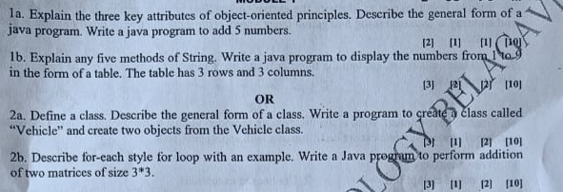

Slide 86
Write a java program to display the numbers in the from 1 to 9 in the form of table. the table has 3 rows 3 columns.
public class NumberTable {
public static void main(String[] args) {
// Constants for rows and columns
int rows = 3;
int columns = 3;
// Variable to track the number
int number = 1;
// Nested loops to print the table
for (int i = 0; i < rows; i++) {
for (int j = 0; j < columns; j++) {
// Print the current number and increment
System.out.print(number + "\t");
number++;
}
// Move to the next line after printing a row
System.out.println();
}
}
}
OutPut
1 2 3
4 5 6
7 8 9

Slide 87
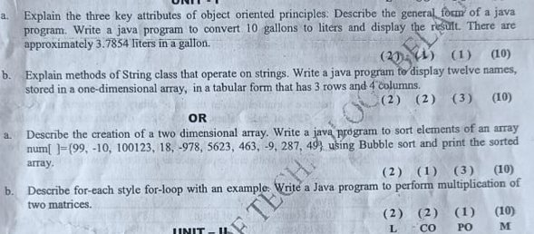

Slide 88
public class NamesArray {
public static void main(String[] args) {
// 1D array with 12 names
String[] names = {
"Alice", "Bob", "Charlie", "David",
"Eva", "Frank", "Grace", "Hank",
"Ivy", "Jack", "Kelly", "Leo"
};
// Displaying the names in a 3x4 table
int rowCount = 3;
int colCount = 4;
int index = 0; // Index to iterate through the names array
for (int i = 0; i < rowCount; i++) {
for (int j = 0; j < colCount; j++) {
// Check if there are still names in the array
if (index < names.length) {
System.out.print(names[index] + "\t");
index++;
}
}
System.out.println(); // Move to the next line after printing a row
}
}
}
Write a java program to display 12 names stored in 1-d array that has 3 rows ,4 columns .
OutPut
Alice Bob Charlie David
Eva Frank Grace Hank
Ivy Jack Kelly Leo

Slide 89
What is the difference between a class and an object? How is class defined in JAVA? Write a Java program to define a class called myTriangle to model a triangle geometrical object with three sides. Include functions to:
Initialize the three sides of triangle.
Compute and return the area of the triangle.

Slide 90
import java.util.Scanner;
class MyTriangle {
private double side1;
private double side2;
private double side3;
// Constructor to initialize the sides of the triangle
public MyTriangle(double s1, double s2, double s3) {
side1 = s1;
side2 = s2;
side3 = s3;
}
// Function to compute and return the area of the triangle
public double calculateArea() {
// Using Heron's formula to calculate the area of the triangle
double s = (side1 + side2 + side3) / 2.0;
double area = Math.sqrt(s * (s - side1) * (s - side2) * (s - side3));
return area;
}
}
public class TriangleDemo {
public static void main(String[] args) {
// Taking input for the sides of the triangle
Scanner scanner = new Scanner(System.in);
System.out.print("Enter the length of side 1: ");
double side1 = scanner.nextDouble();
System.out.print("Enter the length of side 2: ");
double side2 = scanner.nextDouble();
System.out.print("Enter the length of side 3: ");
double side3 = scanner.nextDouble();
// Creating an instance of MyTriangle
MyTriangle myTriangle = new MyTriangle(side1, side2, side3);
// Calculating and displaying the area of the triangle
double area = myTriangle.calculateArea();
System.out.println("Area of the triangle: " + area);
scanner.close();
}
}

Slide 91
TW2: Design a class by name myTriangle to model a triangle geometrical object with three sides. Include functions to:
1. Initialize the three sides of the triangle.
2. Determine the type of triangle represented by the three sides (Equilateral/ Isosceles/ Scalene triangle).
3. Compute and return the area of the triangle.
Note: When three sides are given we use the following formula:
s = (a+b+c) / 2;
area = sqrt(s*(s-a)*(s-b)*(s-c));

Slide 92
import static java.lang.System.exit;
import java.util.Scanner;
class Triangle {
double a,b,c;
void getSides(){
Scanner in=new Scanner(System.in);
System.out.println("Enter 3 sides of a triangle:");
a=in.nextDouble();
b=in.nextDouble();
c=in.nextDouble();
}

Slide 93
void checkTriangle(){
if((a+b)>c && (b+c)>a && (a+c)>b){
if(a==b && b==c && c==a)
System.out.println("Triangle is equilateral");
else if(a==b || b==c || c==a)
System.out.println("Triangle is isosceles");
else
System.out.println("Triangle is scalene");
}
else{
System.out.println("Triangle cannot be formed");
exit(0);
}
}

Slide 94
double computeArea(){
double s=(a+b+c)/2;
double area=Math.sqrt(s*(s-a)*(s-b)*(s-c));
return area;
}
}

Slide 95
public class tw2 {
public static void main(String[] args){
Triangle t=new Triangle();
t.getSides();
t.checkTriangle();
if((t.computeArea())!=0){
System.out.println("Area is "+t.computeArea());
}
}
}

